Slide 1

A HOTTER PLANET, HIGHER SEAS
Project Team: Clarissa Nunez, DJ Dimetros, Jacob Klucher, Toni Makakoa, Mohamoud Jama
BootCamp: UofM-VIRT-DATA-PT-09-2024-U-LOLC-MTTH
November 19, 2024

Slide 2

THE ASK?
What is the current state of global warming and climate change?
How much has the Earth’s average temperature increased since the pre-industrial era?
How much has sea level risen in the past century?

Slide 3




DATA RESEARCH
Gathered data and information from diverse online sources
Searched for existing datasets
Downloaded and imported the necessary datasets

Slide 4

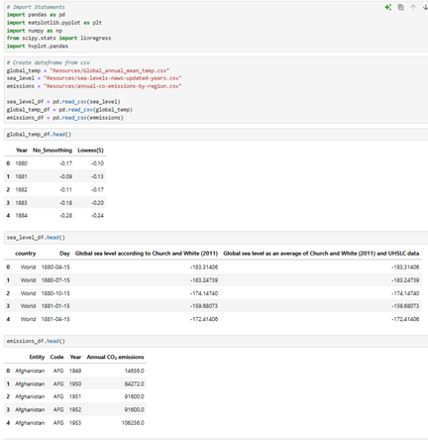
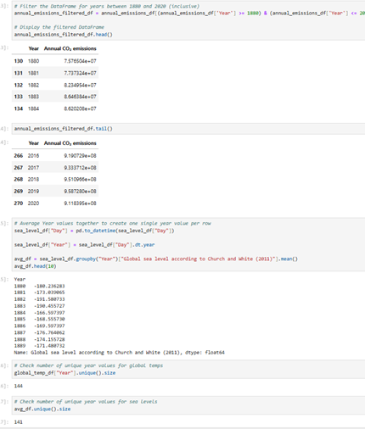
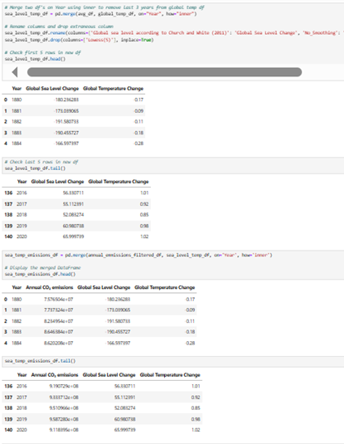
DATA EXPLORATION AND CLEAN UP
HANDLE MISSING VALUES AND OUTLIERS
FORMAT AND PREPROCESS THE DATA FOR VISUALIZATION

Slide 5

THE ANALYSIS

Slide 6
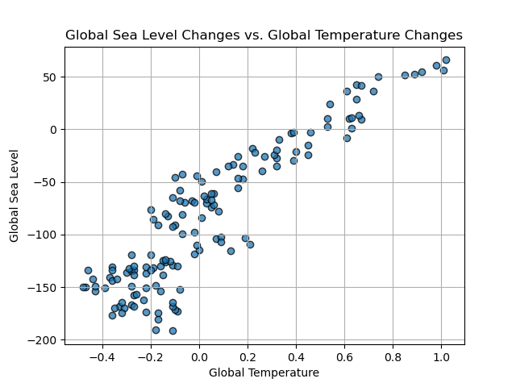
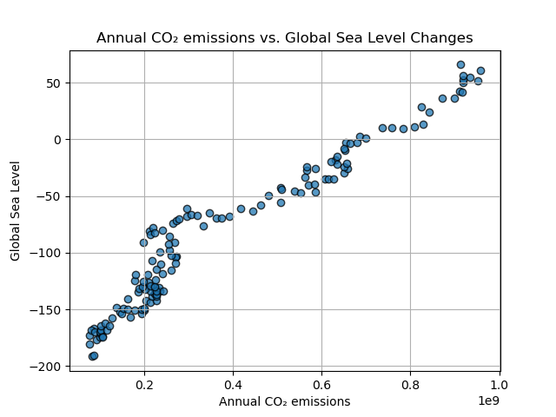
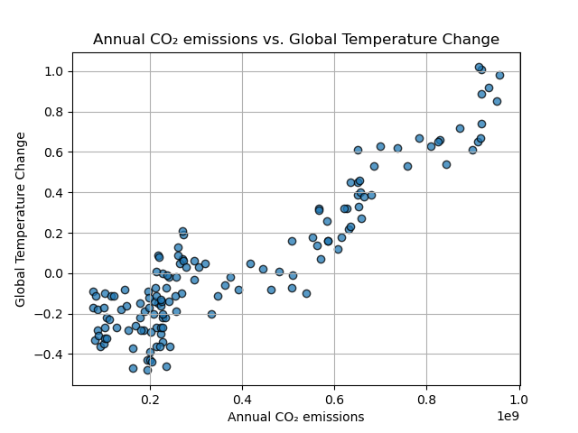
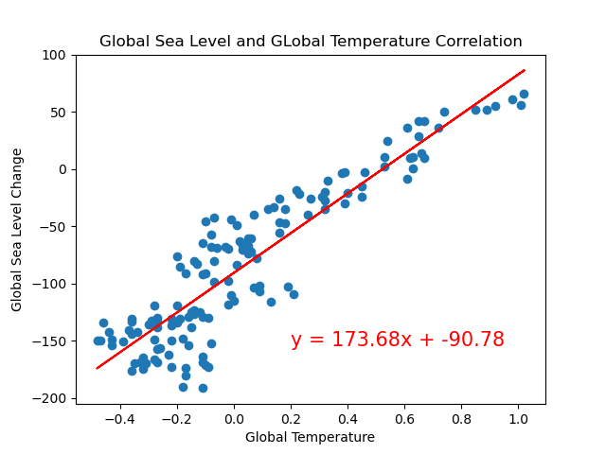
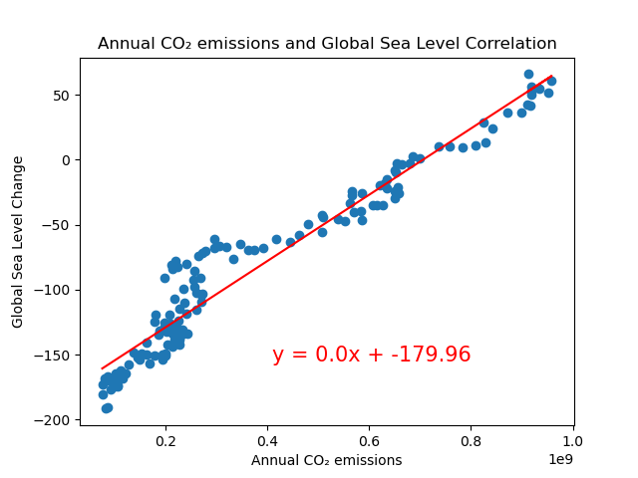
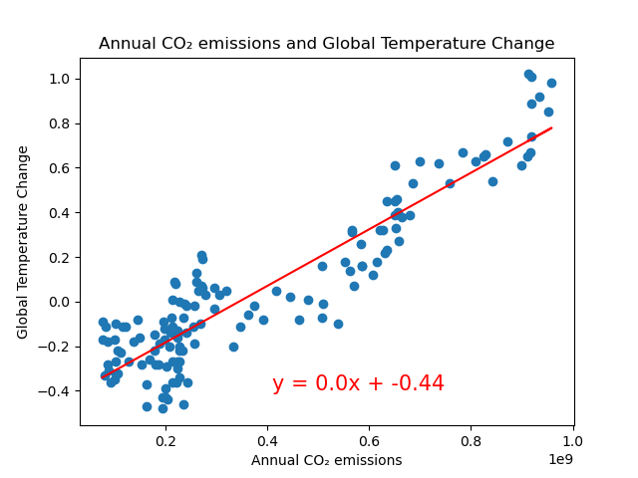
THE ANALYSIS
Sea Level vs Temperature
Emissions vs Sea level
Emissions vs Temperature

Slide 7

CONCLUSIONS
Your conclusions, including a numerical summary and visualization summary

Slide 8

FINDINGS
The implications of your findings: what do your findings mean?

